Slide 1
Heart disease prediction using Machine Learning
Guided by:
Dr. Bipin Bihari Jayasingh
Professor,HoD,IT Dept.
Presented By:
Srilasya -18B81A1241
Sree Tulasi -18B81A1240
Sriya-18B81A1243

Slide 2
Abstract
Heart disease, alternatively known as cardiovascular disease, encases various conditions that impact the heart and is the primary basis of death worldwide over the span of the past few decades.. The goal of this study is to extract hidden patterns by applying data mining techniques, which are noteworthy to heart diseases and to predict the presence of heart disease in patients where this presence is valued from no presence to likely presence.Models based on supervised learning algorithms as Random Forest.So, the need of reliable, accurate and feasible system to diagnose such diseases in time for proper treatment is the major motto behind the model.

Slide 3
Introduction
Over the last decade, heart disease or cardiovascular remains the primary basis of death worldwide.Several different symptoms are associated with heart disease, which makes it difficult to diagnose it quicker and better.
More weight is assigned to the attribute having high impact on disease prediction. Therefore it appears reasonable to try utilizing the knowledge and experience of several specialists collected in databases towards assisting the Diagnosis process. It also provides healthcare professionals an extra source of knowledge for making decisions.
Medical organisations, all around the world, collect data on various health related issues. These data can be exploited using various machine learning techniques to gain useful insights

Slide 4
Introduction(cont…)
Algorithms (here Random Forest) have become very useful, in recent times, to predict the presence or absence of heart related diseases accurately.

Slide 5
Literature review , Limitations
M.A.Nishara Banu and B.Gomathy has given a paper named Disease Predicting system using data mining techniques. In this paper they talk about MAFIA (Maximal Frequent Itemset algorithm) and K-Means clustering. As classification is important for prediction of a disease. The classification based on MAFIA and K-Means results in accuracy.
Wiharto and Hari Kusnanto have given a paper named Intelligence System for Diagnosis Level of Coronary Heart Disease with K-Star Algorithm. In this paper they exhibit an expectation framework for heart infection utilizing Learning vector Quantization neural system calculation.

Slide 6
Mohammed Abdul Khaleel has given paper in the Survey of Techniques for mining of data on Medical Data for Finding Frequent Diseases locally.
In year 2013, S. Vijiyaraniet. Al performed a work, An Efficient Classification Tree Technique for Heart Disease Prediction. This paper analyzes the classification tree techniques in data mining. The classification tree algorithms used and tested in this paper are Decision Stump, Random Forest and LMT Tree algorithm. The objective of this research was to compare the outcomes of the performance of different classification techniques for a heart disease dataset.
Considering the limitations of this study, there is a need to implement more complex and combination of models to get higher accuracy for early prediction of heart disease.

Slide 7
Software requirements
Functional Requirements
Model takes necessary information (symptoms) from the user.
The inputs are processed using algorithms and test results are generated.
Display the output in human readable form using the user interface.
Non functional Requirements
Accuracy:accuracy of the model is more than 80%
Accessibility:is accessible by any person easily.
Portability:can be executed under any platform.

Slide 8
Problem Statement
The main objective of the model is to accurately predict about the user’s condition being on the verge of a cardiovascular disease , which is a growing concern besides many other ailments. The user’s diagnosis test values of various attributes are collected and tested against the available data , which would give us an accurate result of whether the user needs aid to be prone of the heart diseases or not.

Slide 9
Motivation & Scope
Millions of people are getting some sort of heart disease every year and heart disease is the biggest killer of both men and women all around the world.
Medical diagnosis plays a vital role and yet is complicated task that needs to be executed efficiently and accurately.
To reduce cost for achieving clinical tests an appropriate computer based information and decision support should be aided.

Slide 10
Description of modules
Home Page - It has 2 options :
Register (if you a new user)
Login(if already registered)
“Register” Page - It allows the user to enter their details which are stored into the database.Once registered he can either login or go back to the HomePage.
“Login” Page - Here the user enters his credentials which are verified against the data in the database. If the information is verified , the user is directed to the “Enter symptoms” page else he is asked to recheck his information.

Slide 11
“Enter the diagnosis test values” Page- The user enters the test results which will be taken by the system .
The algorithm (random forest) is applied on the test values taken .
Random forest is an ensemble classifier that consists of many decision trees. The output of the classes is represented by individual trees.This method combines with random selection of features to construct a decision trees with controlled variations.
Comparing the entered values with the previous dataset values , a prediction is made if the user is prone to a cardiovascular disease or not.
The prediction is then displayed on the screen.

Slide 12
Hardware & Software Configuration
Hardware Requirements
RAM:512 MB or above
Hard disk:10GB or above
Software Requirements
Platform:Jupyter
User Interface:Python Tkinter
Backend:Python (NumPy,Pandas,Sklearn)
Database:sqlite3

Slide 13
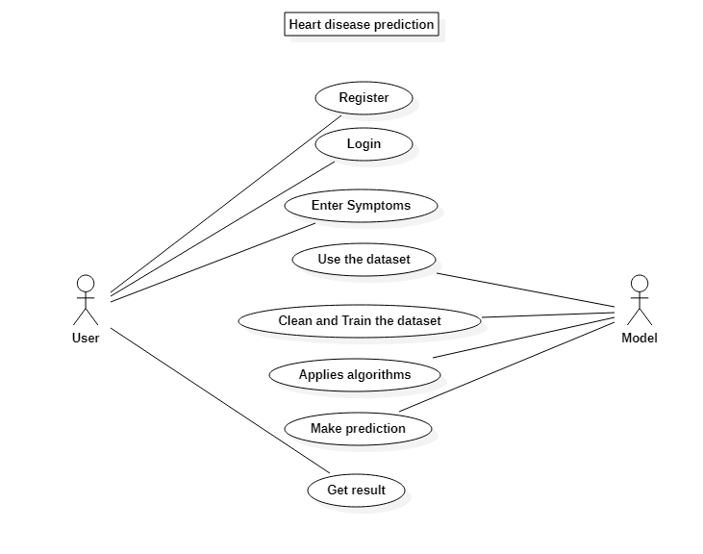
Use case diagram

Slide 14
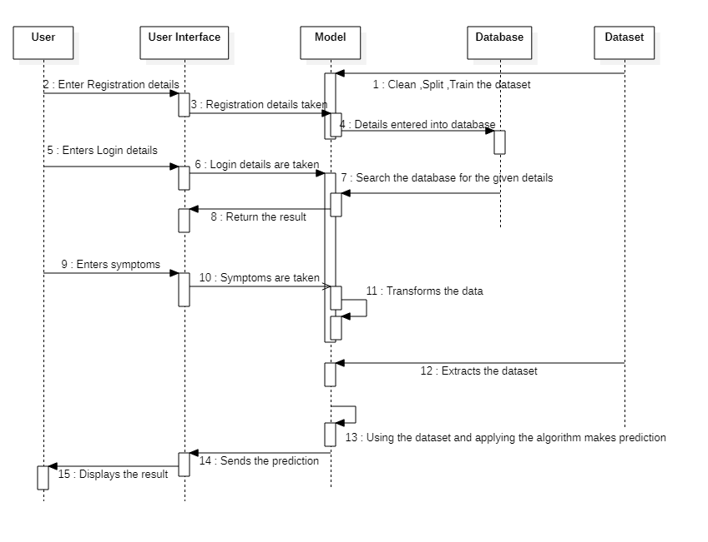
Sequence Diagram

Slide 15
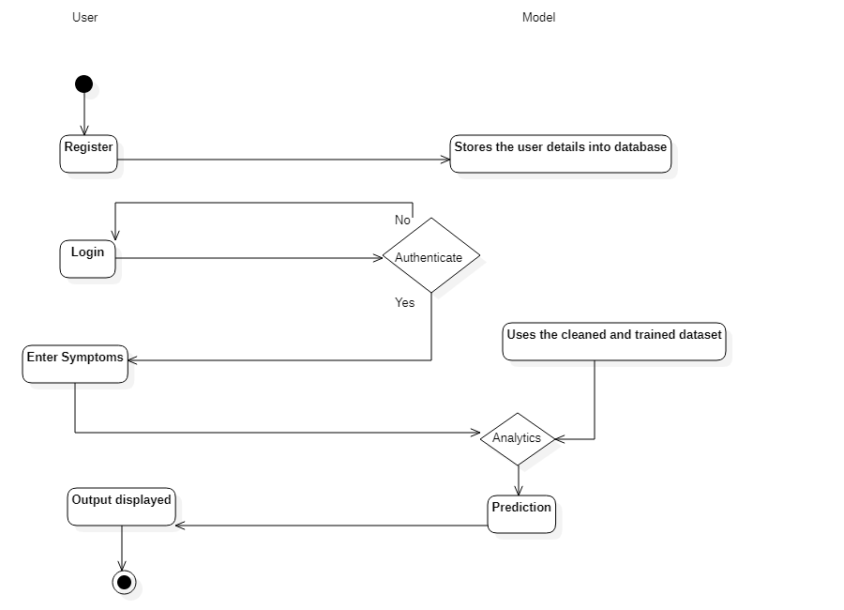
Activity diagram

Slide 16
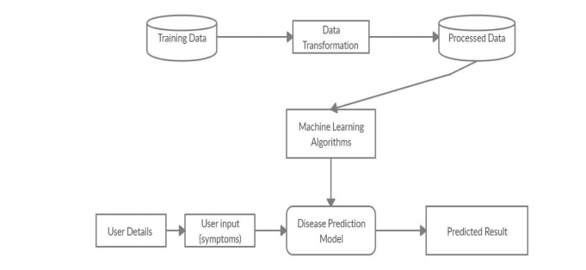
Architecture Diagram

Slide 17
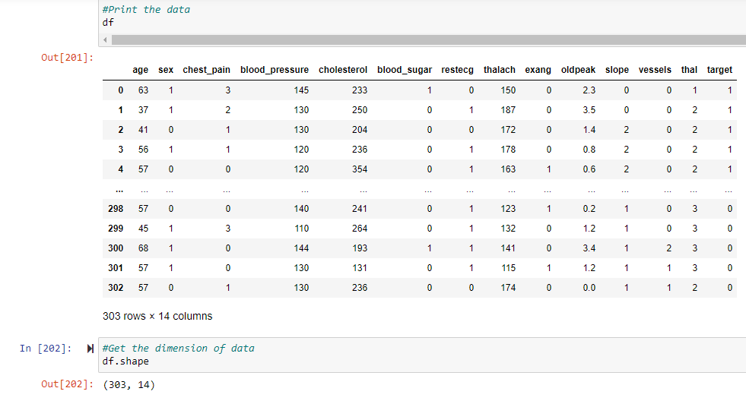
Workflow of the model
Dataset

Slide 18
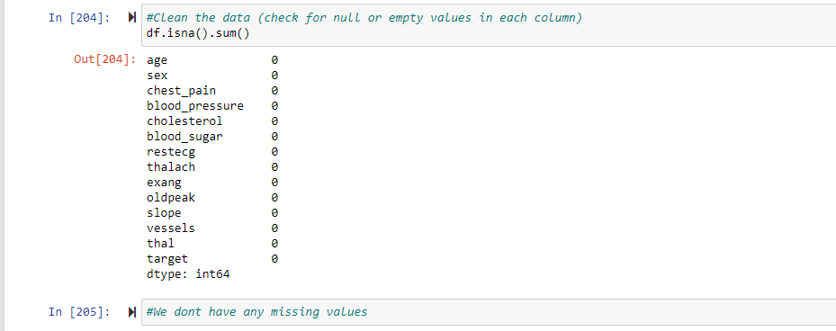
Check if the data has any missing values for cleaning purpose

Slide 19
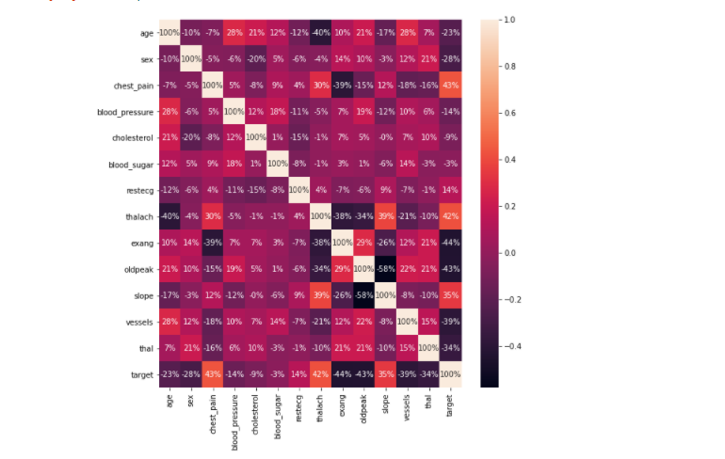
Correlation matrix to identify and visualize patterns in the given data

Slide 20
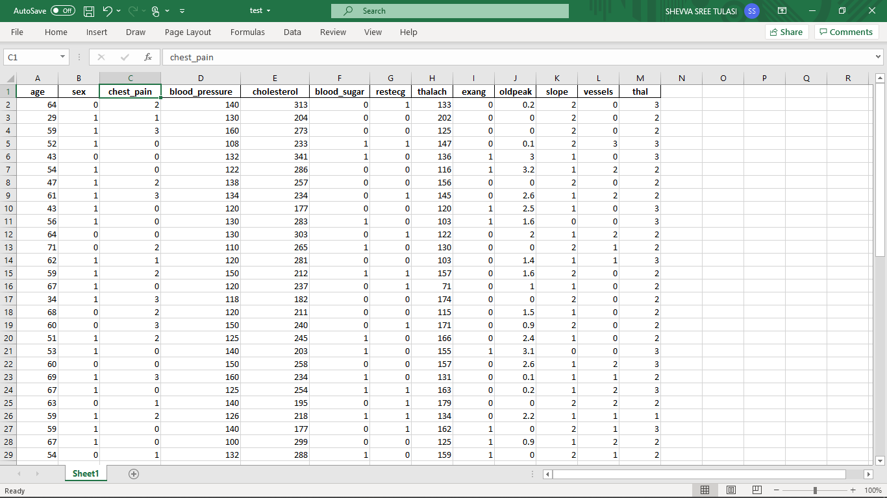
Tested data

Slide 21
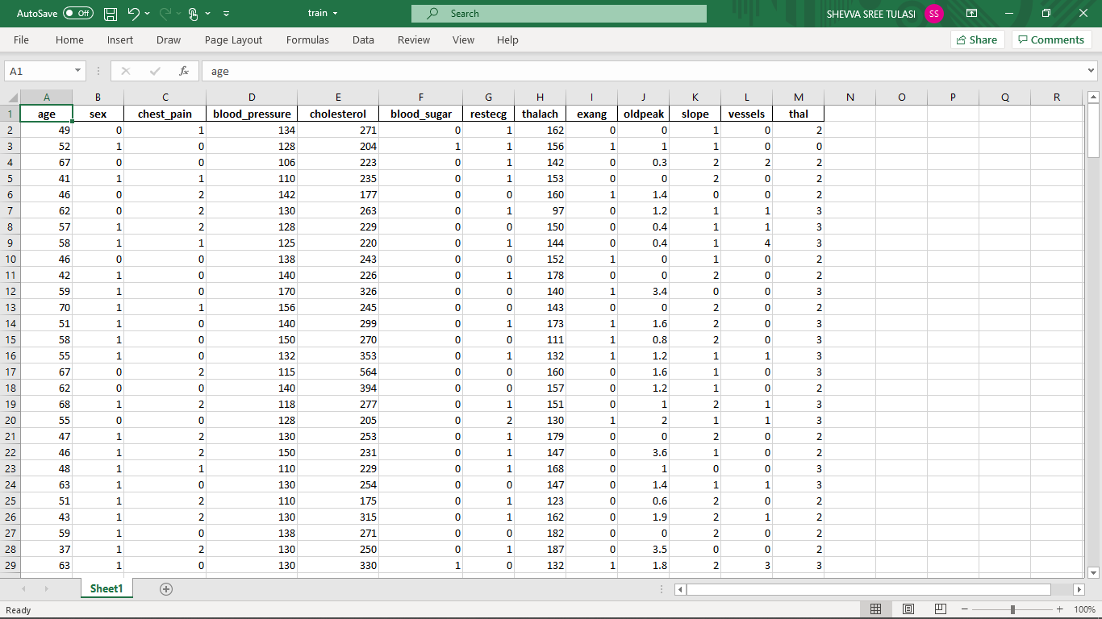
Trained data

Slide 22
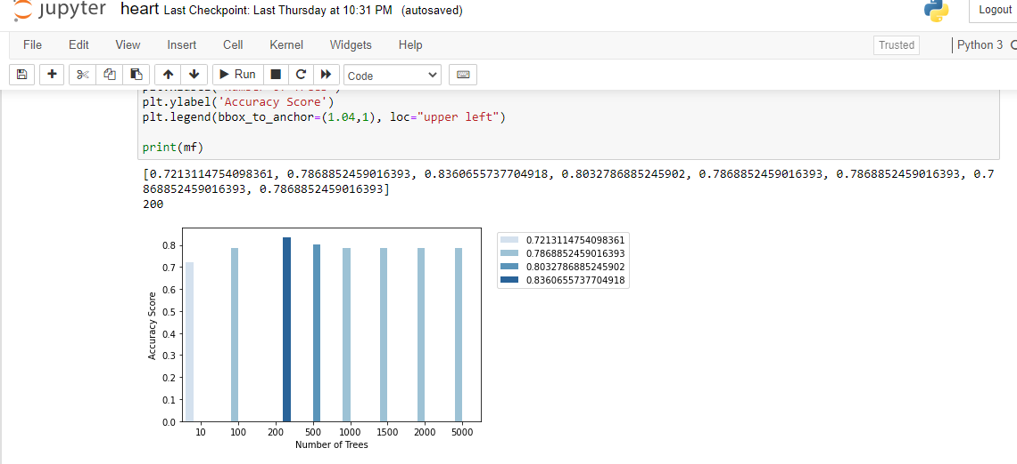
Predicting the n_estimators to give the maximum accuracy

Slide 23
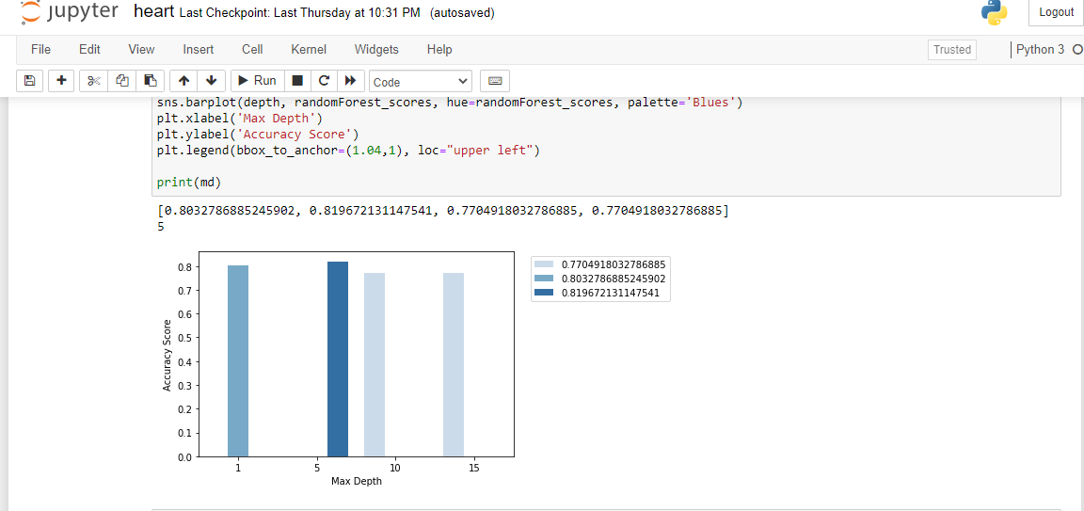
Predicting the max_depth to give the maximum accuracy

Slide 24
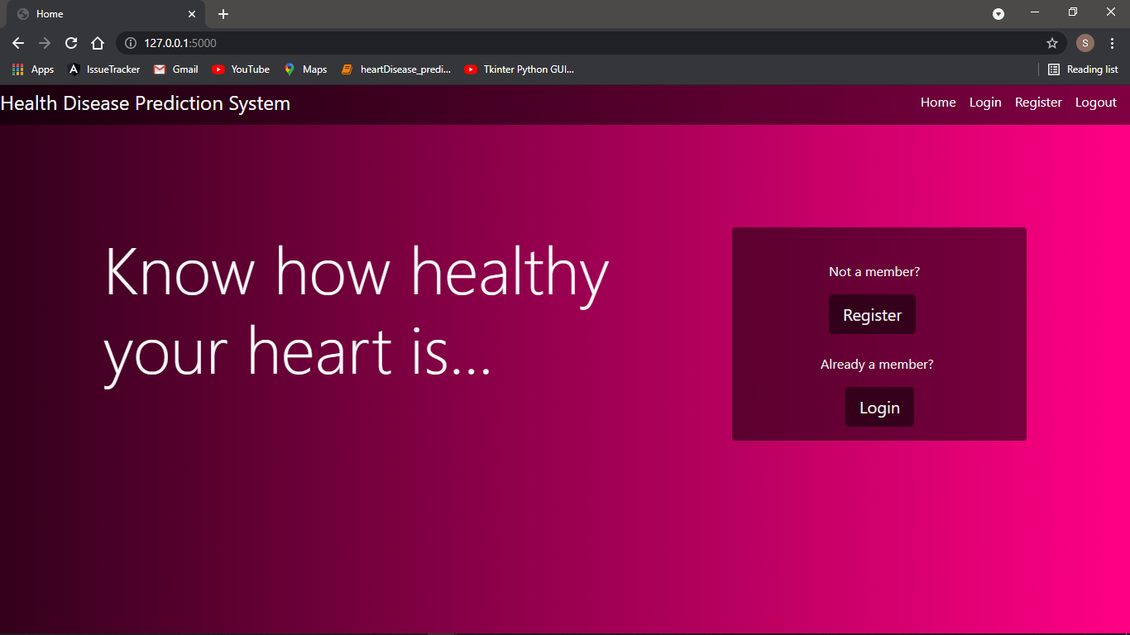
Home Page

Slide 25
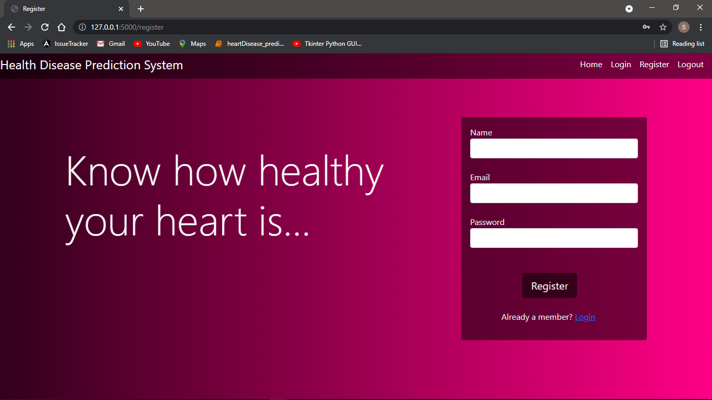
Registration Page

Slide 26
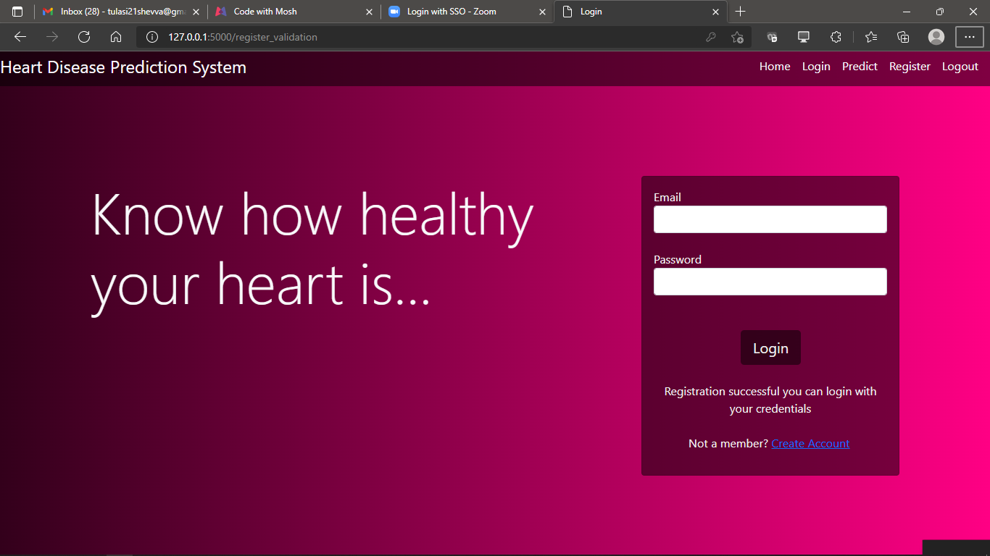
Registration Successful

Slide 27
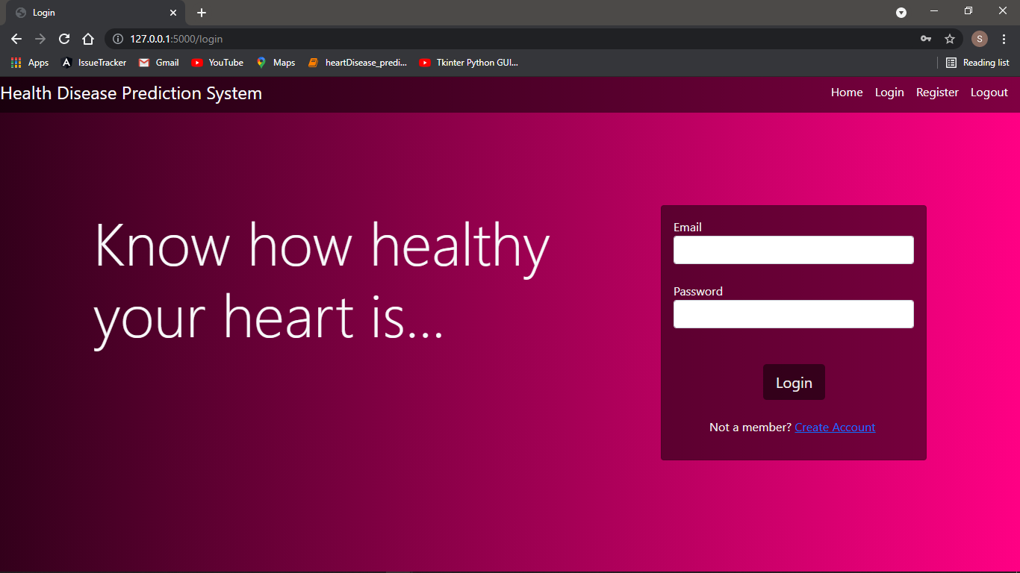
Login Page

Slide 28
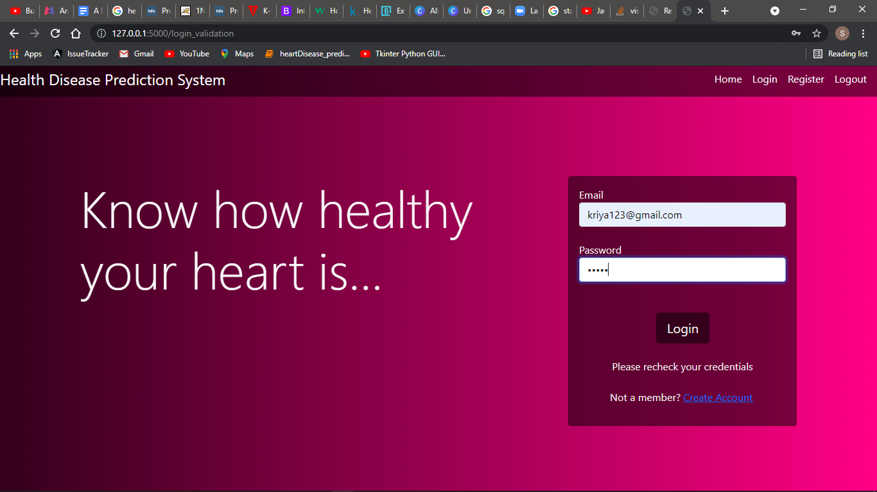
Login credentials wrong

Slide 29
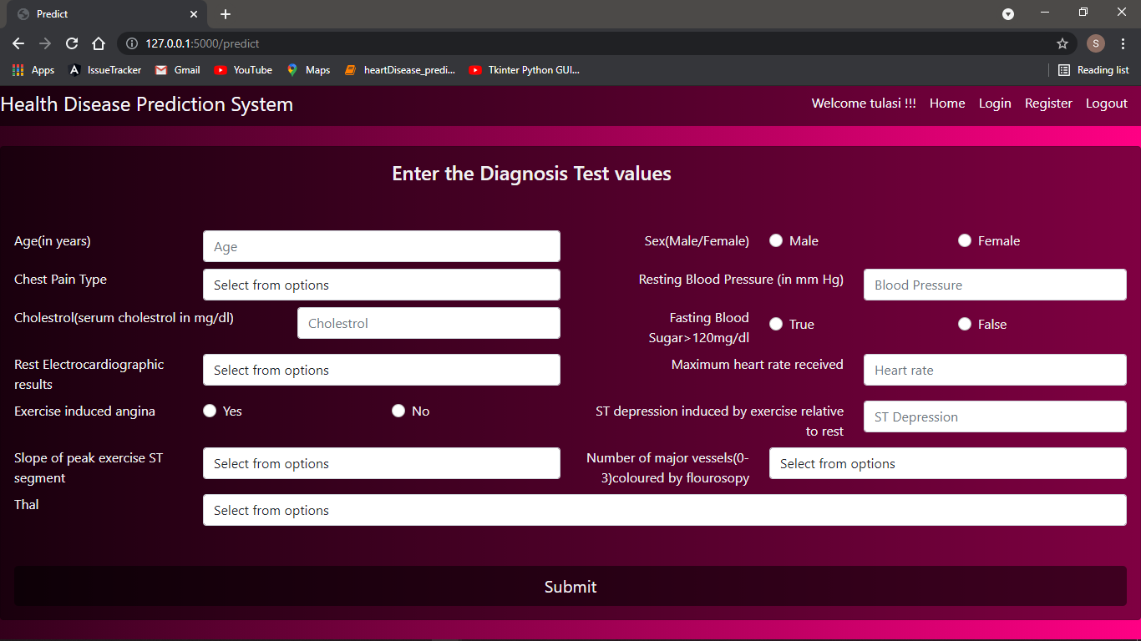
Enter symptoms page(Login successful)

Slide 30
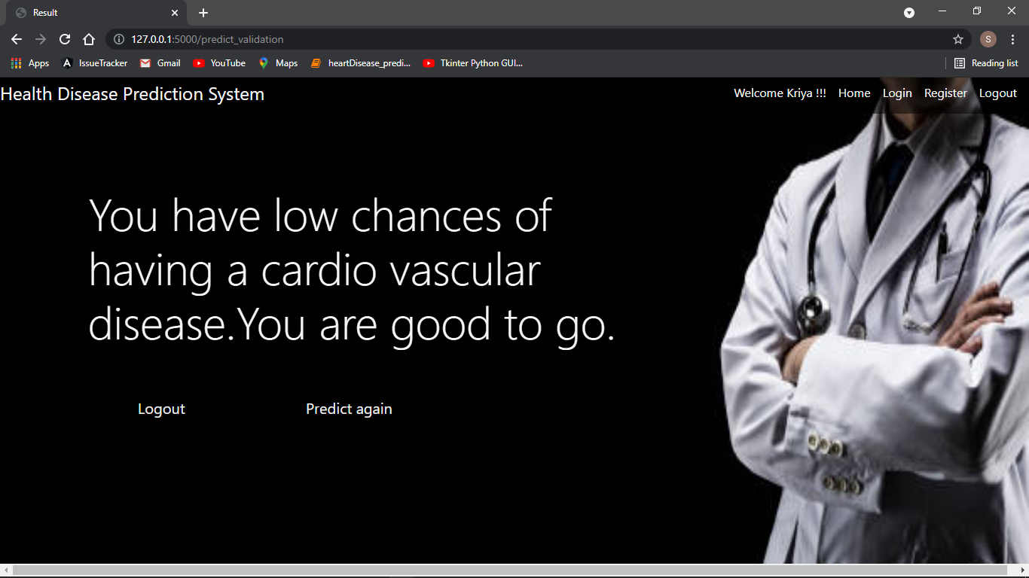
Predicted - person not having cardiovascular disease

Slide 31
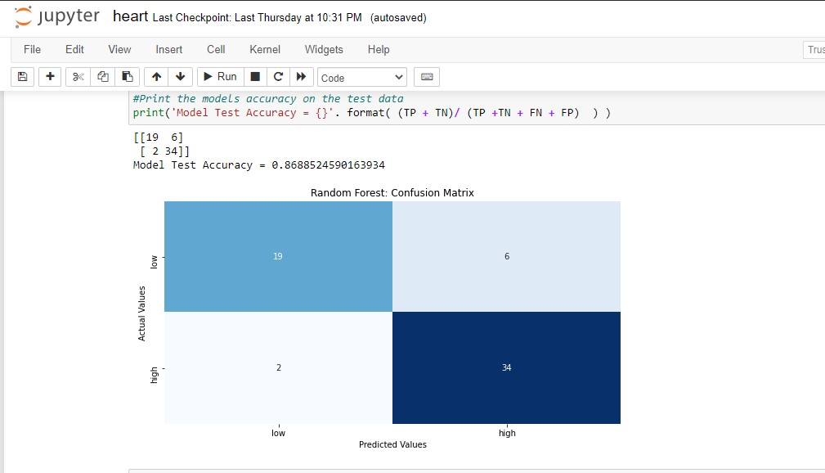
Confusion Matrix

Slide 32
Conclusion and major contribution
The overall aim is to define various data mining techniques useful in effective heart disease prediction. Efficient and accurate
The data were pre-processed and then used in the model.
Random Forest and Ensemble models have performed very well because they solve the problem of overfitting by employing multiple algorithms (multiple Decision Trees in case of Random Forest)prediction with a lesser number of attributes and tests is our goal.

Slide 33
Systems based on machine learning algorithms and techniques have been very accurate in predicting the heart related diseases but still there is a lot scope of research to be done on how to handle high dimensional data and overfitting. A lot of research can also be done on the correct ensemble of algorithms to use for a particular type of data.

Slide 34
Future Enhancements
Enhance the UI of the model.
Improve the accuracy of the model.
Add additional features like “forgot password”,”edit details”.
Provide information to the user such as the doctor details to consult.

Slide 35
References
Python Tutorial - Python for Beginners [Full Course]-https://www.youtube.com/watch?v=_uQrJ0TkZlc
Python Machine Learning Tutorial (Data Science)-https://www.youtube.com/watch?v=7eh4d6sabA0
Python GUI-Tkinter-https://www.geeksforgeeks.org/python-gui-tkinter
SQLite-Python-https://www.tutorialspoint.com/sqlite/sqlite_python.htm

